Slide 1



SWATIMALI@SOMAIYA.EDU
DATA STRUCTURES – TYPES AND ADT

Slide 2
Classification of Data Structure
Primitive Data Structure
Non-Primitive Data Structure

Slide 3
Classification of Data Structure
Data structure
Primitive DS
Non-Primitive DS
Integer
Float
Character
Pointer

Slide 4
Classification of Data Structure
Non-Primitive DS
Linear List
Non-Linear List
Array
Queue
Graph
Trees
Link List
Stack

Slide 5
Primitive data structures
Basic structures that are directly operated upon by the machine instructions.
Usually built into the language, such as an integer, a float.

Slide 6
Non-Primitive data structures
More sophisticated data structures.
Derived from the primitive data structures.
Emphasize on structuring of a group of homogeneous (same type) or heterogeneous (different type) data items.

Slide 7
Data structures and their representations

Slide 8
Stack
Data4
Top
Data3
Data2
Data1

Slide 9
Queue
Data4
Rear
Data3
Data2
Data1
Front

Slide 10
List- A Flexible structure that can grow and shrink on demand
Head
D
A
M
K
Temp
Nil
Head
K
D
A
M
Temp
Nil

Slide 11
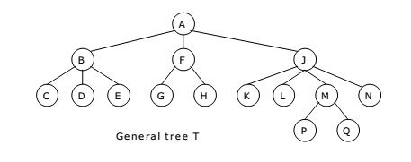
Tree
Image courtesy: ExamRadar.com

Slide 12
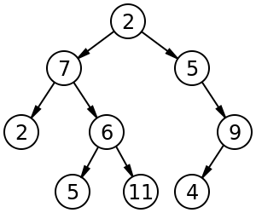
Binary Tree, Binary search tree and Heaps
Image courtesy: ExamRadar.com

Slide 13
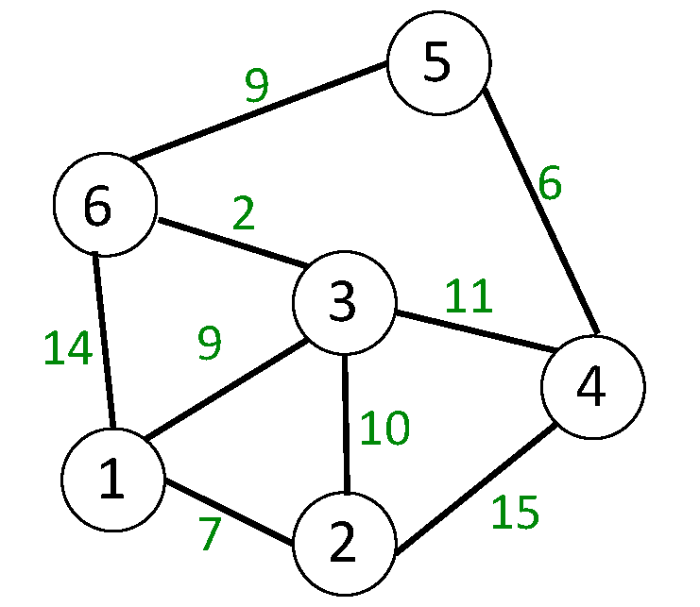
Graph
Image courtesy: Medium.com

Slide 14
Abstract Data Type and Data Structure
Definition:-
Abstract Data Types (ADTs) stores data and allow various operations on the data to access and change it.
A mathematical model, together with various operations defined on the model
An ADT is a collection of data and associated operations for manipulating that data

Slide 15
Abstract Data Type
ADTs support abstraction, encapsulation, and information hiding.
Abstraction is the structuring of a problem into well-defined entities by defining their data and operations.
The principle of hiding the used data structure and to only provide a well-defined interface is known as encapsulation.

Slide 16
ADT Operations
Every Collection ADT should provide a way to:
Create data structure
add an item
remove an item
find, retrieve, or access an item
No single data structure works well for all purposes, and so it is important to know the strengths and limitations of several of them

Slide 17
ADT Syntax : Value Definition
Abstract typedef < ParameterType Parameter1, ParameterType Parameter2……, ParameterType ParameterN > ADTType
condition:

Slide 18
ADT Syntax : Operator definition
Abstract ReturnType OperationName (ParameterType Parameter1, ParameterType Parameter2……, ParameterType ParameterN)
Precondition:
Postcondition:
OR
Abstract ReturnType OperationName (Parameter1, Parameter2……, ParameterN)
ParameterType Parameter1, ParameterType Parameter2……, ParameterType ParameterN
Precondition:
Postcondition:

Slide 19
Abstract Data Structure
Logical Definition
Mathematical definition
ADTs represent concepts
Free from hardware or software dependency
Operation name is assumed as the return variable name

Slide 20
Abstraction
The process of isolating implementation details and extracting only essential property from an entity
Hence, abstractions in a program:
Data abstraction :What operations are needed by the data
Functional abstraction : What is the purpose of a function (algorithm)
Program = data + algorithms
Courtsey: https://www.comp.nus.edu.sg/~stevenha/cs1020e/lectures/L5%20-%20ADT.pdf

Slide 21
ADTs
Abstract Data Type (ADT):
End result of data abstraction
A collection of data together with a set of operations on that data
ADT = Data + Operations
ADT is a language independent concept
Different language supports ADT in different ways
In C++, the class construct is the best match
Courtsey: https://www.comp.nus.edu.sg/~stevenha/cs1020e/lectures/L5%20-%20ADT.pdf

Slide 22
IS ADT a function?

Slide 23
Important Properties of ADT
Specification: The supported operations of the ADT
Implementation: Data structures and actual coding to meet the specification
Courtsey: https://www.comp.nus.edu.sg/~stevenha/cs1020e/lectures/L5%20-%20ADT.pdf

Slide 24
ADT : Specification and Implementation
Specification and implementation are disjointed:
One specification
One or more implementations
Using different data structure
Using different algorithm
Users of ADT:
Aware of the specification only
Usage only base on the specified operations
Do not care / need not know about the actual implementation
i.e. Different implementation do not affect the user
Courtsey: https://www.comp.nus.edu.sg/~stevenha/cs1020e/lectures/L5%20-%20ADT.pdf

Slide 25
Example ADT : String
Definition: String is a sequence of characters
Operations:
StringLength
StringCompare
StringConcat
StringCopy

Slide 26
Example ADT : String
Value Definition
Abstract Typedef StringType<<Chars>>
Condition: None (A string may contain n characters where n=>0)

Slide 27
Example ADT : String Operator Definition
1. abstract Integer StringLength (StringType String)
Precondition: None (A string may contain n characters where n=>0)
Postcondition: Stringlength= NumberOfCharacters(String)

Slide 28
Example ADT : String Operator Definition
2. abstract StringType StringConcat( StringType String1, StringType String2)
Precondition: None
Postcondition: StringConcat= String1+String2 / All the characters in Strings1 immediately followed by all the characters in String2 are returned as result.

Slide 29
Example ADT : String Operator Definition
3. abstract Boolean StringCompare( StringType String1, StringType String2)
Precondition: None
Postcondition: StringCompare= True if strings are equal, StringCompare= False if they are unequal . (Function returns 1 if strings are same, otherwise zero)

Slide 30
Example ADT : String Operator Definition
4. abstract StringType StringCopy( StringType String1, StringType String2)
Precondition: None
Postcondition: StringCopy: String1= String2 / All the characters in Strings2 are copied/overwritten into String1.

Slide 31
Example ADT : Rational Number
Definition: expressed as the quotient or fraction of two integers,
Operations:
IsEqualRational()
MultiplyRationa()
AddRational()

Slide 32
Example ADT : Rational Number
Value Definition
abstract TypeDef<integer, integer> RATIONALType;
Condition: RATIONALType [1]!=0;

Slide 33
Example ADT : Rational Number Operator Definition
abstract RATIONALType makerational<a,b>
integer a,b;
Preconditon: b!=0;
postcondition :
makerational [0] =a; makerational [1] =b;
abstract RATIONALtype add<a,b>
RATIONALType a,b;
Precondition: none
postcondition :
add[0] = a[0]*b[1]+b[0]*a[1]
add[1] = a[1] * b[1]

Slide 34
Example ADT : Rational Number Operator Definition
abstract RATIONALType mult<a, b>
RATIONALType a,b;
Precondition: none
postcondition
mult[0] = = a[0]*b[0]
mult[1] = = a[1]*b[1]
abstract RetunType? Equal<a,b>
RATIONALType a,b;
Precondition: none
postcondition equal = |a[0] * b[1] = = b[0] * a[1];

Slide 35
Abstract Data Types: Advantages
Hide the unnecessary details by building walls around the data and operations
o that changes in either will not affect other program components that use them
Functionalities are less likely to change
Localize rather than globalize changes
Help manage software complexity
Easier software maintenance
Courtsey: https://www.comp.nus.edu.sg/~stevenha/cs1020e/lectures/L5%20-%20ADT.pdf

Slide 36
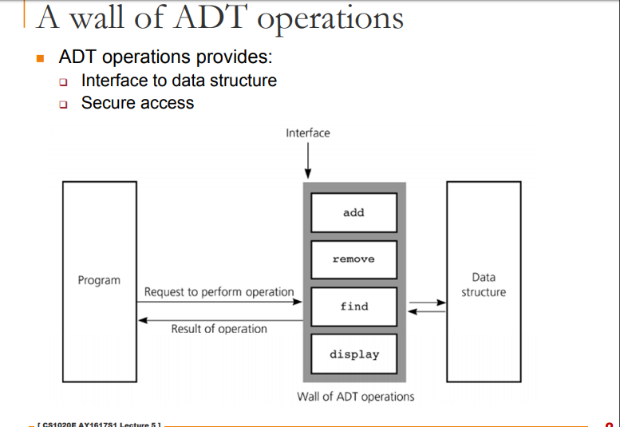
Courtsey: https://www.comp.nus.edu.sg/~stevenha/cs1020e/lectures/L5%20-%20ADT.pdf

Slide 37
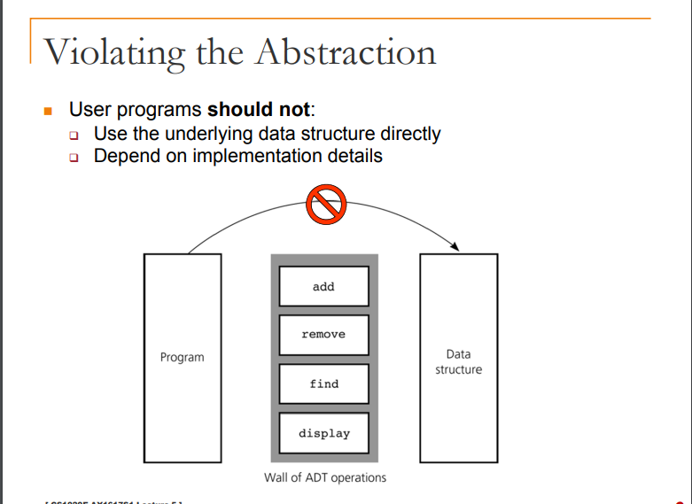
Courtsey: https://www.comp.nus.edu.sg/~stevenha/cs1020e/lectures/L5%20-%20ADT.pdf

Slide 38
ADT Implementation
Computer languages do not provide complex ADT packages.
To create a complex ADT, it is first implemented and kept in a library.

Slide 39
Abstract TypeDef StackType
Condition:

Slide 40
Thank you

